Slide 1
Special Relativity
The Road Towards Modern Physics
Dara Daneshvar, Eason Shao
Physics Problem Solving
20/05/2024

Slide 2
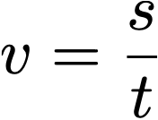
Prior Knowledge
The speed of light is constant for all observers
Nothing else

Slide 3
What we will talk about
Lorentz Transforms
Consequences of Special Relativity
A taste of Minkowski Space

Slide 4
Why Special Relativity

Slide 5
Late 19th Century
Maxwell’s electromagnetism gave rise to the idea of light as an electromagnetic wave.
Many believed that it propagated through something called the aether, which filled the universe.
They believed that the aether could represent an absolute reference frame.

Slide 6
Einstein
Unfortunately this was experimentally falsified (Michelson-Morley) …
but nobody really noticed its significance until Lorentz …
whose paper inspired Einstein to discover what we are going to talk about today.
Einstein’s solution was to argue that:
The Aether didn’t exist
The laws of physics - including the measurement of the speed of light - is the same for any inertial reference frame.
This would mean that if I travel at 100,000 m/s, I still measure speed of light to be 299,792,458 m/s and so would a ‘stationary observer’

Slide 7
The Lorentz Transform

Slide 8
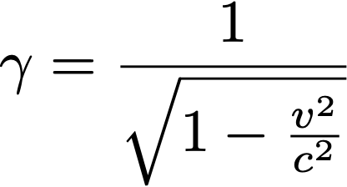
Mathematical Formulation
To formulate the effects of time dilation, we can make use of a photon clock
Use the diagram that Dara is drawing on the board to derive what is known as the Lorentz Factor:
Notes:
I.e. t1 is the time experience by someone who sees a clock moving, and t is the time experienced by someone who sees the clock stationary. t1=gamma*t.
Note that the more general one for multiple moving observers is t1 = gamma(t+vx/c^2)

Slide 9
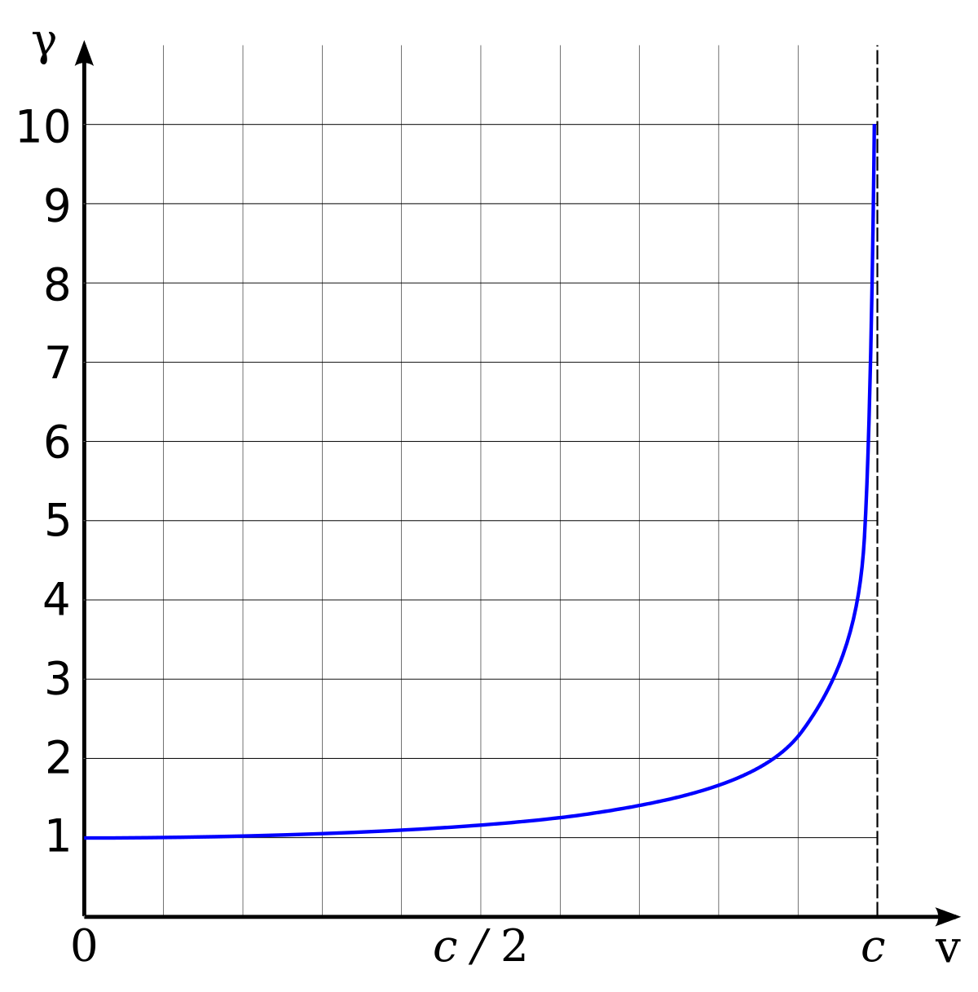
Visualisation
For your Lorentz factor to be 2, you need to travel at 87% the speed of light!

Slide 10
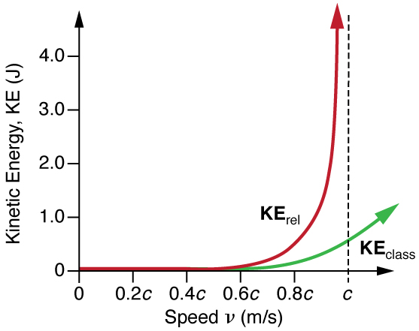


More Consequences
Kinetic Energy (try doing a binomial expansion)
Lorentz Transformation (1D)
Notes:
Take derivative of length contraction with respect to x to find how lengths contract (currently it’s just a coordinate transformation)

Slide 11
Direct Results

Slide 12
Cosmic Rays
Muons are formed at the top of the atmosphere (~ 12000m) due to the decay of cosmic rays. We observe 25% of them reaching the surface of the earth.
Without relativity, because of their half life of just 1.5 microseconds, how fast would they have to travel in order to cause this result?
How does relativity save us here?

Slide 13
Light Cone

Slide 14
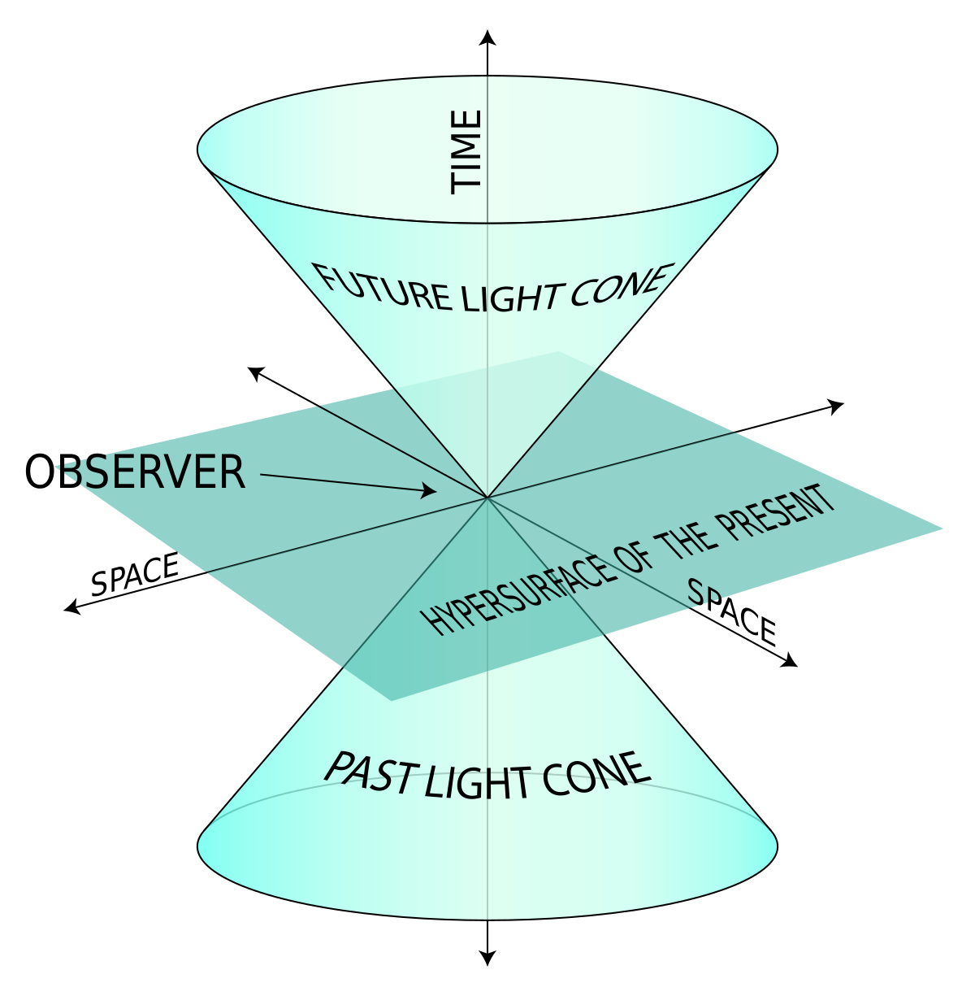
The Light Cone
You may have seen pictures like this in videos or articles about special relativity, but what does it tell us?

Slide 15
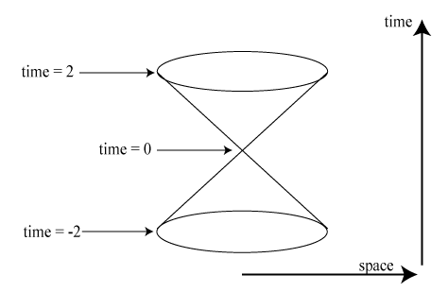
It is a reminder that light has finite speed
Light takes time to go between you and me, therefore you are seeing me in the past.
The “vertex” of this light cone represents an event
To be able to observe or interact with this event, you must be in the light cone
Note the labels on the axes.
Notes:
Click slide to add red dot (event)
Click slide to add observer (cute)
Explain that observer currently can’t see event coz no time has passed
Click again to move observer up into light cone.
Explain that light has had time to reach him now, so he is able to see the event.
Overall explanation - a light cone is a representation of if things are able to interact, under the assumption that light has finite speed.

Slide 16
A Taste of Minkowski Space

Slide 17
Eason will try and talk about the very basics …
https://www.desmos.com/calculator/wtoyyzbwml (Eason loves Desmos as usual …)
If you want to go beyond this, some terms that you might wish to search on Google/Wikipedia:
Minkowski Plane, Space, Metric & Pseudo-Euclidean Space (Some Maths)
Hyperbolic Orthogonality (Some More Maths)
Spacetime Diagram (Minkowski & Loedel Diagrams)
Lorentz Transformation (Physical, Mathematical & Tensor formulation)
Lorentz Group (which is related to Lie Groups & Lie Algebra)

Slide 18
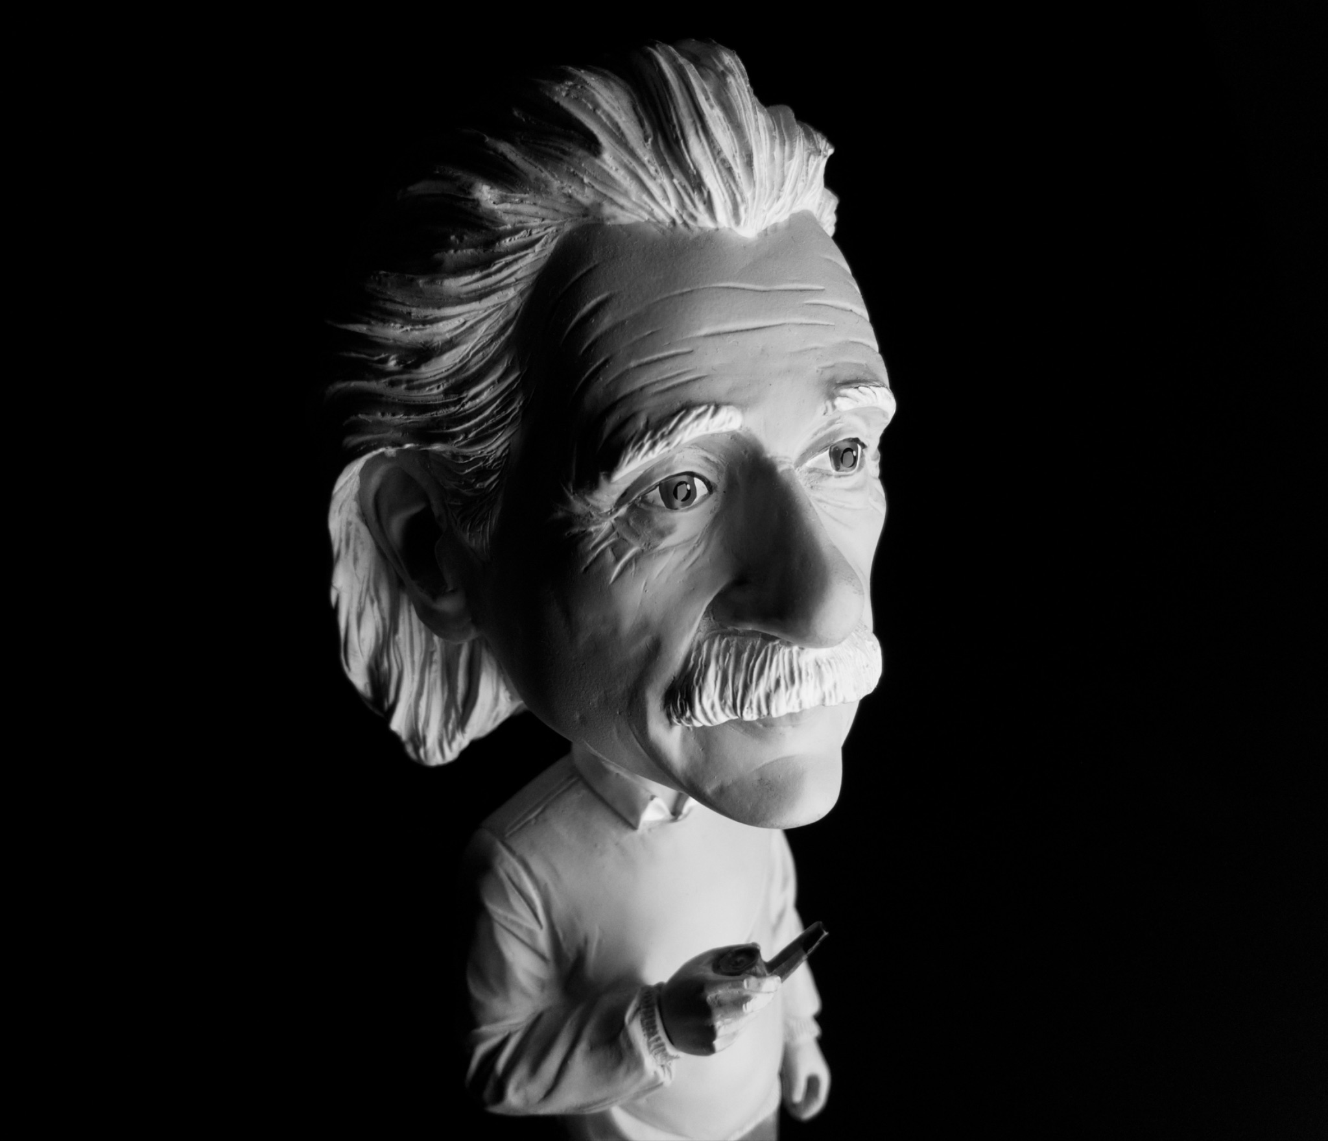
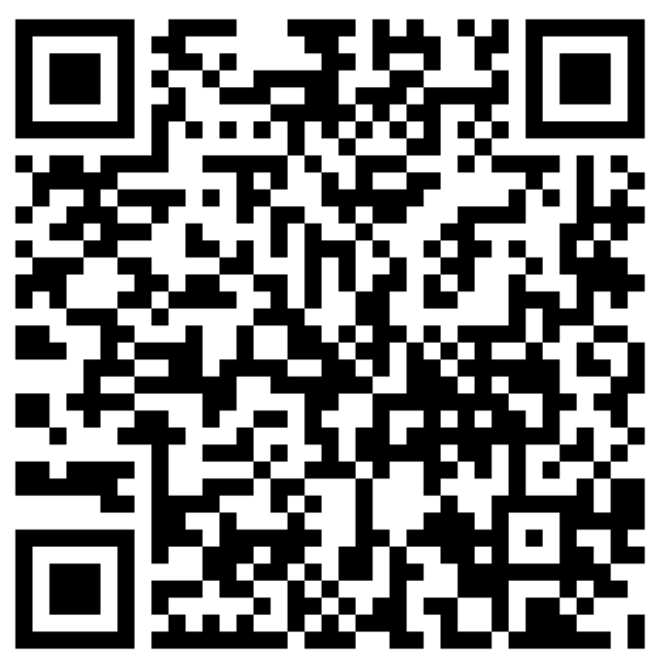
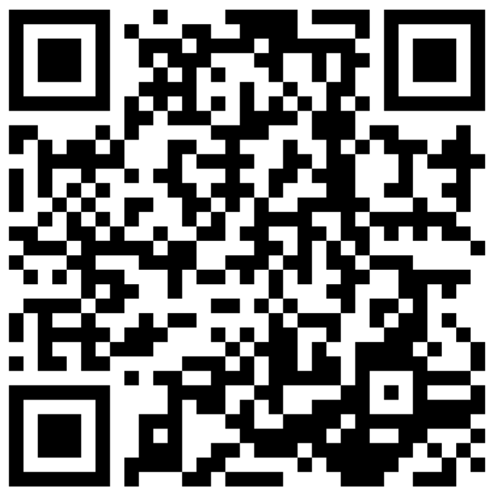
Thanks!
Please ask questions.
Google Classroom: JE3ZZL6

